Slide 1
ETHEREUM AND SMART CONTRACTS - INTRODUCTION -
TRANSITION – Project Reference: 2019-1-MT01-KA202-051255
This project is funded by the European Union ERASMUS+ Program – Key Action 2 Cooperation for innovation and the exchange of good practices.

Slide 2
Summary
1. What is Ethereum?
1.1 Definition and General Overview
1.2 Ethereum Virtual Machine
1.3 Accounts and Keys
1.4 Wallet & Token
2. Smart Contract
2.1 Definition
2.2 Historical Background
2.3 Features of Smart Contracts
TRANSITION – Project Reference: 2019-1-MT01-KA202-051255
This project is funded by the European Union ERASMUS+ Program – Key Action 2 Cooperation for innovation and the exchange of good practices.

Slide 3
Summary
2.4 Creation of an Ethereum Smart Contract
2.5 How does a Smart Contract work?
2.7. Smart Contracts and the Law
3. Decentralized applications (Dapps)
4. Gas & Fees
5. Decentralized autonomous organizations (DAOs)
6. The DAO attack
7. Forks
7.1 Soft Forks
TRANSITION – Project Reference: 2019-1-MT01-KA202-051255
This project is funded by the European Union ERASMUS+ Program – Key Action 2 Cooperation for innovation and the exchange of good practices.

Slide 4
Summary
7.2 Hard Forks
7. 3 Ethereum’s Hard Forks
8. Initial Coin Offerings (ICOs)
8.1 Differences between IPO and ICO
8.2 How does an ICO work?
TRANSITION – Project Reference: 2019-1-MT01-KA202-051255
This project is funded by the European Union ERASMUS+ Program – Key Action 2 Cooperation for innovation and the exchange of good practices.

Slide 5
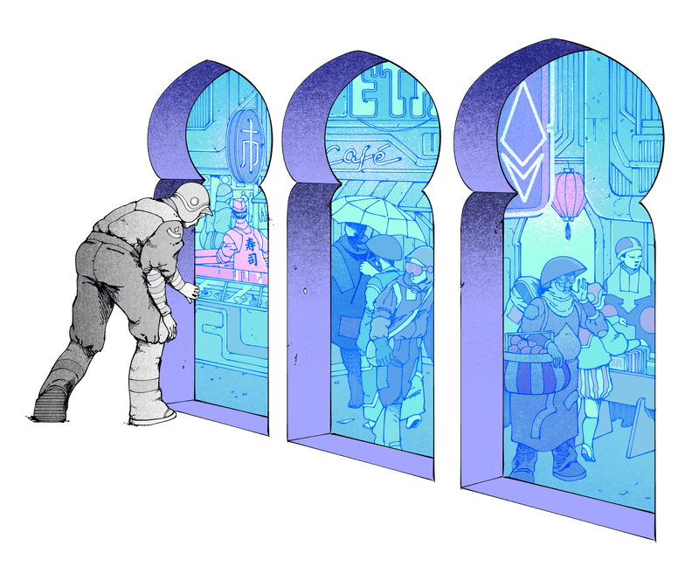
1. What is Ethereum?
[1]
TRANSITION – Project Reference: 2019-1-MT01-KA202-051255
This project is funded by the European Union ERASMUS+ Program – Key Action 2 Cooperation for innovation and the exchange of good practices.

Slide 6
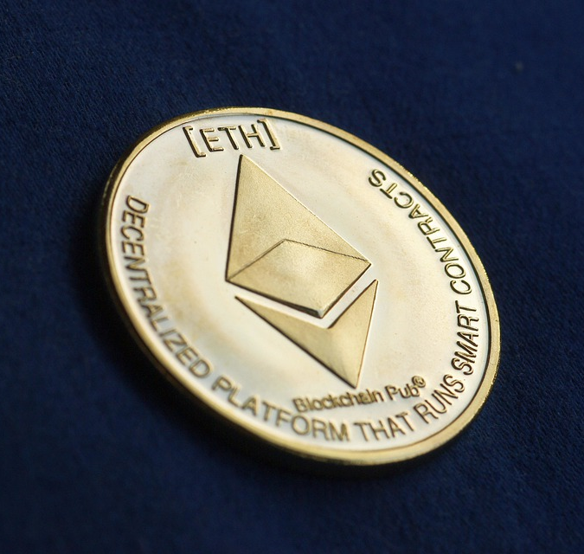
1.1 Definition and General Overview
Ethereum is a peer-to-peer platform (P2P) based on Blockchain technology and it has the following features:
It allows access to digital money, the coding of smart contracts and the creation of decentralised applications (Dapp);
It may be deemed as a transaction-based state machine;
It works through the Ethereum Virtual Machine (EVM);
Its cryptocurrency is called Ether (ETH).
TRANSITION – Project Reference: 2019-1-MT01-KA202-051255
This project is funded by the European Union ERASMUS+ Program – Key Action 2 Cooperation for innovation and the exchange of good practices.

Slide 7
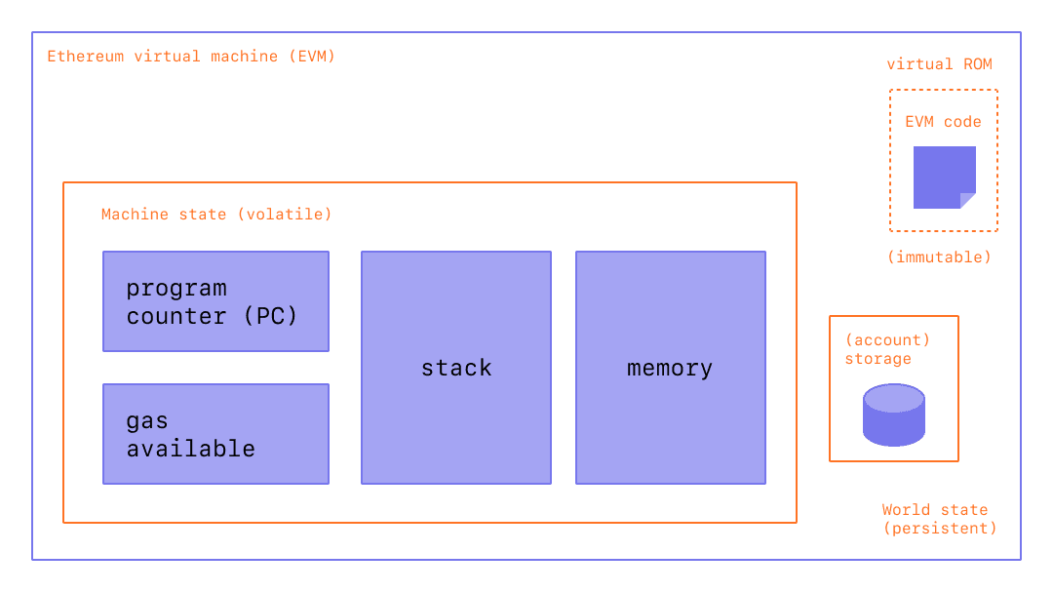
1.2 Ethereum Virtual Machine
[2]
TRANSITION – Project Reference: 2019-1-MT01-KA202-051255
This project is funded by the European Union ERASMUS+ Program – Key Action 2 Cooperation for innovation and the exchange of good practices.

Slide 8
1.2 Ethereum Virtual Machine
The Ethereum Virtual Machine (EVM) is a computational engine which acts like a decentralized computer.
The EVM is deemed as a turing-complete virtual machine that executes codes exactly as intended and it is able to solve any computation problem.
Note that, every change of state of such “global computer” is registered: a new block is broadcasted to the nodes in the network, checked and verified, thus updating the state of the blockchain for everyone.
TRANSITION – Project Reference: 2019-1-MT01-KA202-051255
This project is funded by the European Union ERASMUS+ Program – Key Action 2 Cooperation for innovation and the exchange of good practices.

Slide 9
1.2 Ethereum Virtual Machine
Every computer running software of the network (so-called “Ethereum Node”) runs on the EVM in order to maintain consensus across the blockchain. As a consequence, there will be a running copy of EVM in each node of the system.
Ethereum uses a consensus mechanism called PoW (Proof-of-Work). It allows the nodes to agree on the state of information, therefore ensuring that the chain is difficult to attack or overwrite.
The scope of PoW is to extend the chain “by consensus”, keeping also in mind that it is (usually) impossible to create new blocks that amend/erase transactions or create fake ones, as well as to build a second chain.
TRANSITION – Project Reference: 2019-1-MT01-KA202-051255
This project is funded by the European Union ERASMUS+ Program – Key Action 2 Cooperation for innovation and the exchange of good practices.

Slide 10
1.3 Accounts and Keys
Ethereum has two types of account:
user-controlled accounts - Externally Owned Accounts (EOAs)
accounts deployed as smart contracts - Contracts Accounts
They are equally treated under the EVM.
Both accounts are able to receive, hold and send ETH/tokens, as well as to interact with deployed smart contracts.
[3]
TRANSITION – Project Reference: 2019-1-MT01-KA202-051255
This project is funded by the European Union ERASMUS+ Program – Key Action 2 Cooperation for innovation and the exchange of good practices.

Slide 11
1.3 Accounts and Keys
Here some differences between the two of them.
EXTERNALLY-OWNED ACCOUNT | CONTRACT ACCOUNT
- Zero costs of creation | - Cost of creation
- Owned by a real user | - Owned by the logic of the smart contract code itself
- Able to initiate transactions | - Not able to initiate transaction
- Contains a users’s private key, meaning that it has direct access over a user’s money | - Does not have a private key, therefore it cannot initiate a transaction
- Don’t contain any code | - Has a Smart Contract code
- Send money and change blockchain state | - Can send messages to other Contracts (in response to a transaction initiated by an EOA)
TRANSITION – Project Reference: 2019-1-MT01-KA202-051255
This project is funded by the European Union ERASMUS+ Program – Key Action 2 Cooperation for innovation and the exchange of good practices.

Slide 12
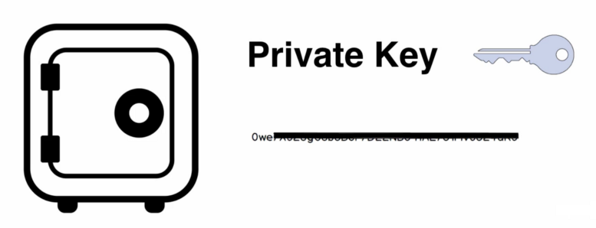
1.3 Accounts and Keys
An Ethereum account has an Ethereum address used to send and receive funds to/from another account, i.e. receive or send transactions on the blockchain.
Moreover, an account consists of a cryptographic pair of keys (public and private) which helps to prove that a transaction was actually signed by the sender, simultaneously preventing forgeries.
Private and public key together establish a mechanism that ensures the constant possibility to verify the sender of a transaction, preventing third parties from broadcasting fake transactions.
[4]
TRANSITION – Project Reference: 2019-1-MT01-KA202-051255
This project is funded by the European Union ERASMUS+ Program – Key Action 2 Cooperation for innovation and the exchange of good practices.

Slide 13
1.4 Wallet & Token
WALLETS 🡪 Wallets on Ethereum are applications that let users interact with their Ethereum account and therefore manage what the user owns. However, note that wallets don't have custody of funds, the user does.
There are four types of Wallets: Hardware Wallet, Mobile Wallet, Web Wallet and Desktop Wallet.
TOKEN 🡪 The Ethereum blockchain allows users to own, besides Ether, also the “Tokens” which are used to represent assets (digital or material) or a right to an asset (ownership to an asset or the access to a service).
They can be generated by a Dapp or by a Smart Contract and they can be exchanged within Ethereum blockchain.
TRANSITION – Project Reference: 2019-1-MT01-KA202-051255
This project is funded by the European Union ERASMUS+ Program – Key Action 2 Cooperation for innovation and the exchange of good practices.

Slide 14
2. SMART CONTRACT
“A smart contract is a self-executing contract with the terms of the agreement between buyer and seller being directly written into lines of code.”¹
¹ https://www.investopedia.com/terms/s/smart-contracts.asp
TRANSITION – Project Reference: 2019-1-MT01-KA202-051255
This project is funded by the European Union ERASMUS+ Program – Key Action 2 Cooperation for innovation and the exchange of good practices.

Slide 15
2.1 Definition
Smart Contracts are like contracts in the real world. The difference is that they are completely digital: a Smart Contract consists of a computer program which is inside a blockchain. “Smart Contracts” can regulate the exchange of money, properties, shares and any asset with a value. They are self-executing computer programs with the terms of the buyer’s and seller’s agreement directly embedded into lines of code;
TRANSITION – Project Reference: 2019-1-MT01-KA202-051255
This project is funded by the European Union ERASMUS+ Program – Key Action 2 Cooperation for innovation and the exchange of good practices.

Slide 16
2.1 Definition
[5]
TRANSITION – Project Reference: 2019-1-MT01-KA202-051255
This project is funded by the European Union ERASMUS+ Program – Key Action 2 Cooperation for innovation and the exchange of good practices.

Slide 17
2.1 Definition
Smart contracts can also be defined as transaction protocol for which help from third parties is not needed.
Smart contracts reduce:
Time: they can be verified in minutes
Money: there is no need for trustworthy intermediaries
Mistakes: there is no need to fill in documents by hands
TRANSITION – Project Reference: 2019-1-MT01-KA202-051255
This project is funded by the European Union ERASMUS+ Program – Key Action 2 Cooperation for innovation and the exchange of good practices.

Slide 18
2.2 Historical Background?
Nick Szabo first developed the “Smart Contract” concept in 1996 via his publication Smart Contract:
1994
Nick Szabo introduced smart contracts
2008
Nakamoto introduced the blockchain
2012
Rise of the cryptocurrency
2015
Etherum popularized the smart contract concept
Mainstream popularity and adoption
Smart Contract Timeline
^{[6]}
TRANSITION – Project Reference: 2019-1-MT01-KA202-051255
This project is funded by the European Union ERASMUS+ Program – Key Action 2 Cooperation for innovation and the exchange of good practices.

Slide 19
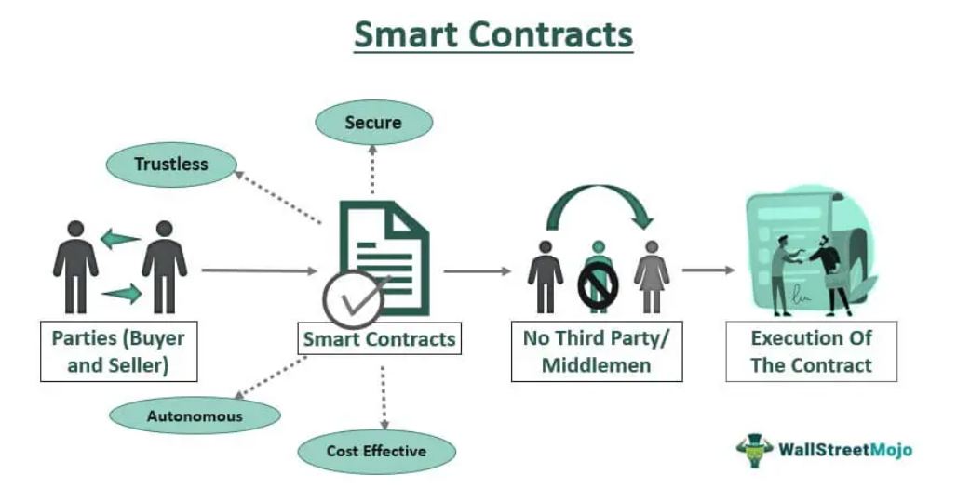
2.3 Features of smart contracts
^{[7]}
TRANSITION – Project Reference: 2019-1-MT01-KA202-051255
This project is funded by the European Union ERASMUS+ Program – Key Action 2 Cooperation for innovation and the exchange of good practices.

Slide 20
2.3 Features of smart contracts
Accuracy
Transparency
Clear Communication
Speed
Security
Efficiency
Paper Free
Storage & Backup
Savings
Trust
Guaranteed Outcomes
Immutable
Distributed
TRANSITION – Project Reference: 2019-1-MT01-KA202-051255
This project is funded by the European Union ERASMUS+ Program – Key Action 2 Cooperation for innovation and the exchange of good practices.

Slide 21
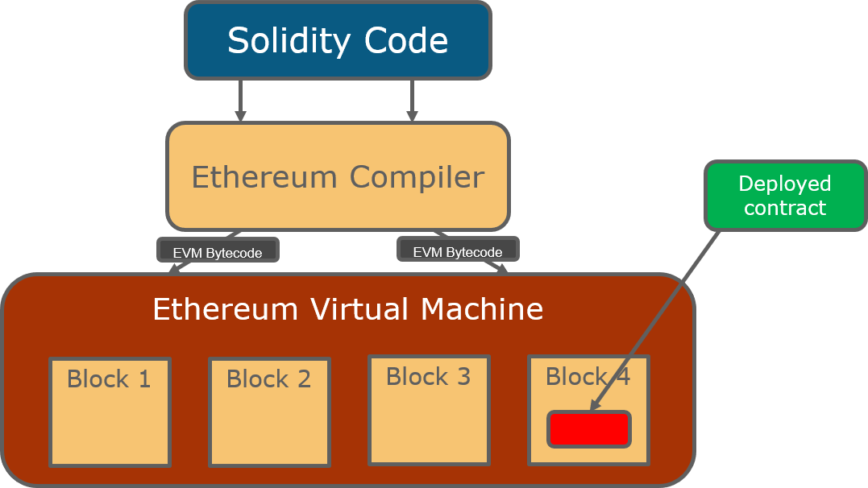
2.4 Creation of an Ethereum Smart Contract
^{[8]}
TRANSITION – Project Reference: 2019-1-MT01-KA202-051255
This project is funded by the European Union ERASMUS+ Program – Key Action 2 Cooperation for innovation and the exchange of good practices.

Slide 22
2.5 Creation of a Smart Contract
The main programming language used for writing Smart Contracts is Solidity. In order to be stored on EVM the contract written with Solidity needs to be encoded into bytecodes. This process is being carried out by using the Solidity Compiler “Solc”.
By deploying smart contracts, they are made available to users of an Ethereum Network.
TRANSITION – Project Reference: 2019-1-MT01-KA202-051255
This project is funded by the European Union ERASMUS+ Program – Key Action 2 Cooperation for innovation and the exchange of good practices.

Slide 23
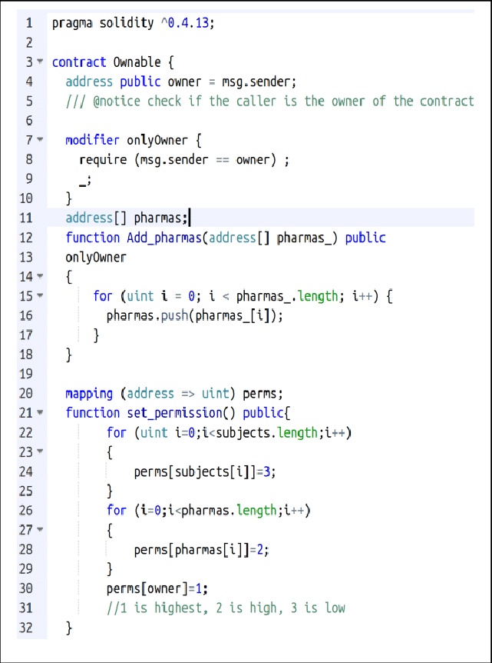
2.5 Creation of a Smart Contract?
^{[9]}
Example of a Smart Contract
TRANSITION – Project Reference: 2019-1-MT01-KA202-051255
This project is funded by the European Union ERASMUS+ Program – Key Action 2 Cooperation for innovation and the exchange of good practices.

Slide 24
2.6 How does a Smart Contact work?
A smart contract is a type of Etherum account and, therefore also called Smart Contract account.
Smart contact accounts do not have private keys but only public keys. They cannot be controlled by users but run as programmed.
^{[10]}
TRANSITION – Project Reference: 2019-1-MT01-KA202-051255
This project is funded by the European Union ERASMUS+ Program – Key Action 2 Cooperation for innovation and the exchange of good practices.

Slide 25
2.6 How does a Smart Contact work?
^{[11]}
TRANSITION – Project Reference: 2019-1-MT01-KA202-051255
This project is funded by the European Union ERASMUS+ Program – Key Action 2 Cooperation for innovation and the exchange of good practices.

Slide 26
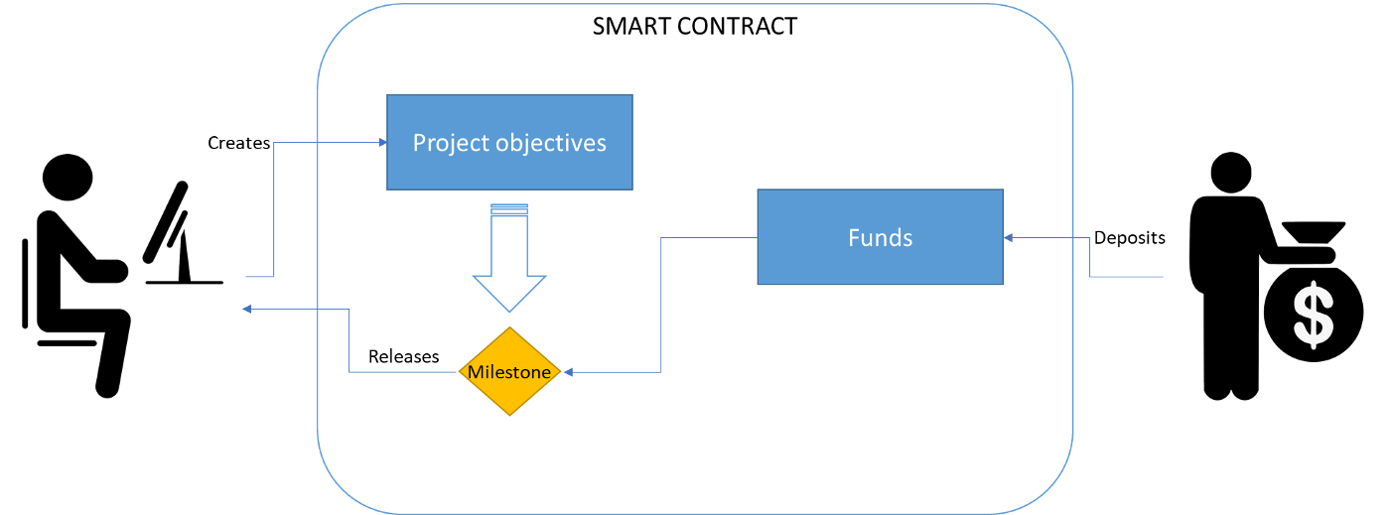
2.6 How does a Smart Contract Work?
^{[12]}
Example for Fundraising: “A smart contract can be programmed so that it holds all the raised money until the goals of the project are met. The donors can transfer the money to the smart contact. Only if the project is fully funded the money will be transferred to the creator of the project. Otherwise, the money will go back to the donors.” ²
https://stefano-tempesta.medium.com/smart-contracts-simply-explained-5f5140a24c95
TRANSITION – Project Reference: 2019-1-MT01-KA202-051255
This project is funded by the European Union ERASMUS+ Program – Key Action 2 Cooperation for innovation and the exchange of good practices.

Slide 27
2.6 How does a Smart Contract Work?
Example “Let’s imagine that John wants to buy Mike’s house. This agreement is formed on the Ethereum blockchain using a smart contract. This smart contract contains an agreement between John and Mike.
In the simplest terms, the agreement will look like this: “WHEN John pays Mike 300 Ether, THEN John will receive ownership of the house”.
Once this smart contract agreement has been put into place, it cannot be changed — meaning John can feel safe to pay Mike 300 Ether for the house.
Without the use of a smart contract in this scenario, Mike and John would have to pay lots of fees to third-party companies. Including the bank, a lawyer and a house broker.” ³
3 https://www.bitdegree.org/crypto/tutorials/what-is-a-smart-contract
TRANSITION – Project Reference: 2019-1-MT01-KA202-051255
This project is funded by the European Union ERASMUS+ Program – Key Action 2 Cooperation for innovation and the exchange of good practices.

Slide 28
2.7 Smart Contracts and the Law?
There are two types of Smart Contracts:
Smart legal contracts, which are smart contracts on a blockchain that represent - or that would like to represent - a legal contract, along with the issues that involves.
Smart contracts with legal implications, which are artefacts/constructs based on smart technology that clearly have legal implications.
TRANSITION – Project Reference: 2019-1-MT01-KA202-051255
This project is funded by the European Union ERASMUS+ Program – Key Action 2 Cooperation for innovation and the exchange of good practices.

Slide 29
3. Decentralised Applications (Dapp)
Dapp (“Decentralized Application”) refers to a type of applications based on a decentralised network.
Dapps use the Ethereum blockchain for data storage and smart contracts for their app logic. Plus, once on the Ethereum network, nobody can change them.
The Dapps, as any traditional application, have three basic structures, and namely: frontend, backend and data storage level.
They are decentralized, deterministic, turing complete and isolated.
[13]
TRANSITION – Project Reference: 2019-1-MT01-KA202-051255
This project is funded by the European Union ERASMUS+ Program – Key Action 2 Cooperation for innovation and the exchange of good practices.

Slide 30
4. Gas & Fees
Each operation on the chain requires a fee in order to be executed: “GAS” is the fee needed by Ethereum. Gas fees guarantees a secure network, preventing actors from spamming it. Furthermore, for the purpose of avoiding computational wastage in code (such as loops), a limit to how many computational steps of code execution it can use is set.
Example: A has to pay B 1 ETH, the gas limit in this transaction is 21,000 units and the gas price is 200 gwei.
Total fee to be paid: Gas units limit * Gas price per unit = 21,000 * 200 = 4,200,000 gwei 🡪 0.0042 ETH
A sends the money, 1.0042 ETH will be deducted from A’s account
B receives 1 ETH
Miner gets 0.0042 ETH
TRANSITION – Project Reference: 2019-1-MT01-KA202-051255
This project is funded by the European Union ERASMUS+ Program – Key Action 2 Cooperation for innovation and the exchange of good practices.

Slide 31
4. Gas & Fees
The gas limit represent the maximum amount of gas the user is willing to consume for the transaction (e.g. a standard ETH transfer requires a gas limit of 21,000 units of gas).
Whenever a wrong gas limit is set, the EVM will either not complete the transaction or return the unused gas to the user.
Example 🡪 Simple ETH transfer requiring a limit of 21,000 units:
If the limit set is 30,000, the EVM will consume 21,000 units and give back the remaining 9,000 to the user.
If the limit set is 18,000, the EVM will consume 18,000 units attempting to complete the transaction, but won’t succeed, however, the 18,000 gas units already consumed won’t be given back.
TRANSITION – Project Reference: 2019-1-MT01-KA202-051255
This project is funded by the European Union ERASMUS+ Program – Key Action 2 Cooperation for innovation and the exchange of good practices.

Slide 32
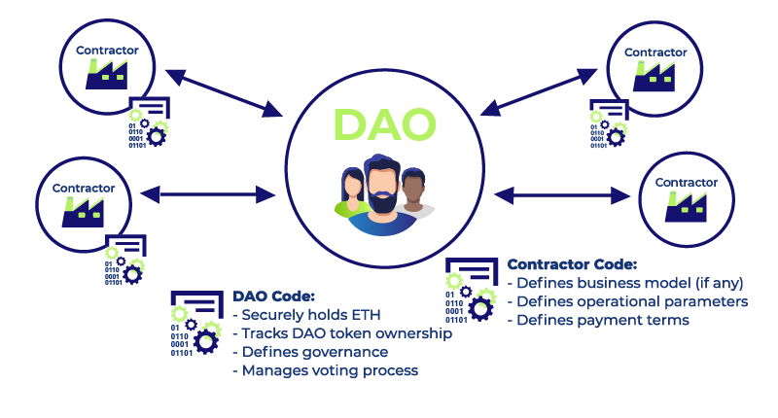
5. Decentralized autonomous organizations (DAOs)
DAO (Decentalised Autonomous Organisation):
Organization governed by an informatic code and capable of working autonomously without a central authority
Safe way to collaborate (also with internet strangers)
Member-owned communities
Place to commit funds to a common project
Dao’s features:
Fully democratized
Activities are transparent and public
To implement changes, a vote by the members is required
Services offered are automatically handled (in a decentralized way)
[14]
TRANSITION – Project Reference: 2019-1-MT01-KA202-051255
This project is funded by the European Union ERASMUS+ Program – Key Action 2 Cooperation for innovation and the exchange of good practices.

Slide 33
5. Decentralized autonomous organizations (DAOs)
The relevant Smart Contract of a DAO (deemed as its pillar) rules the organization and keeps the related treasury.
Nobody can change the contract once on the chain: the only exception to that is making changes by voting. This mechanism also prevent from spending the money (treasury) without the groups’ approval. As an inevitable result, the DAOs don’t need a central authority and decisions are taken collectively and the payments follows the votes.
Examples of possible uses of a DAO:
Charity
Creation of a freelancer network where the contractors collect their funds
Building of ventures and grants
TRANSITION – Project Reference: 2019-1-MT01-KA202-051255
This project is funded by the European Union ERASMUS+ Program – Key Action 2 Cooperation for innovation and the exchange of good practices.

Slide 34
6. The DAO attack
The DAO involved in the 2016 attack had a fund’s value was around $150 million in ether.
The hacker managed to drain 3.6 million Ether (ca. $50 million) into a personal account thanks to a chink in the DAO’s code.
Unfortunately, this event was a solid proof that blockchain is not flawless.
In order to remedy the damage, three options have been proposed:
To do nothing, letting the stakeholders losing their investment;
“hard-fork”, meaning restoring the blockchain as it was before the attack;
“soft-fork” by blocking the Ether stolen by the hacker indefinitely, in other words, freezing the hacker’s account and then stealing the money back.
TRANSITION – Project Reference: 2019-1-MT01-KA202-051255
This project is funded by the European Union ERASMUS+ Program – Key Action 2 Cooperation for innovation and the exchange of good practices.

Slide 35
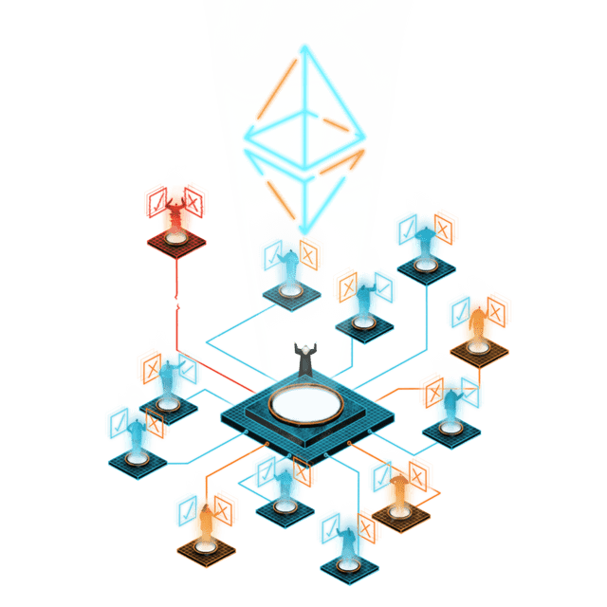
6. The DAO attack
Long story short, option b) was the final choice. It has been voted and accepted by the Ethereum community and, therefore, implemented.
Though the majority of stakeholders agreed on the hard fork, not everyone did the same. As a result, two separate competing Ethereum blockchain arose:
Ethereum Classic (ETC), the pre-forked blockchain version
Ethereum, the blockchain that implemented the hard fork
[15]
TRANSITION – Project Reference: 2019-1-MT01-KA202-051255
This project is funded by the European Union ERASMUS+ Program – Key Action 2 Cooperation for innovation and the exchange of good practices.

Slide 36
7. Forks
Like any software, also blockchain needs to be updated. These updates are called forks. There are two types of forks:
Hard Forks
Soft Forks
TRANSITION – Project Reference: 2019-1-MT01-KA202-051255
This project is funded by the European Union ERASMUS+ Program – Key Action 2 Cooperation for innovation and the exchange of good practices.

Slide 37
7. 1 Soft Forks
Soft forks are called soft because they don’t change anything surrounding the actual structure of the protocol.
Explained simply: a soft fork is the type of breakup where you remain friends with your ex. If the developers decide to fork the cryptocurrency and make the changes compatible with the old one, then the situation is called a soft fork.
TRANSITION – Project Reference: 2019-1-MT01-KA202-051255
This project is funded by the European Union ERASMUS+ Program – Key Action 2 Cooperation for innovation and the exchange of good practices.

Slide 38
7. 1 Soft Forks
Example: “The protocol's already existing rules dictate that a block must reach 5MB, and then it is attached to the blockchain. However, now the protocol is updated, and the blocks are supposed to be only 3MB until they are pinned to the blockchain. Since the older nodes can append blocks with a storage capacity of 5MB, they are now also able to append blocks with 3MB to the blockchain. Thus, both old and new nodes can append blocks to the blockchain.
However, if old nodes try to append a block with 5MB to the blockchain, the new nodes will be rejected because this block does not comply with the new rules of the protocol. Over time, the old nodes now also only follow the rules of the new protocol.”⁴
4 What are Soft Forks and Hard Forks? | Coinmonks (medium.com)
TRANSITION – Project Reference: 2019-1-MT01-KA202-051255
This project is funded by the European Union ERASMUS+ Program – Key Action 2 Cooperation for innovation and the exchange of good practices.

Slide 39
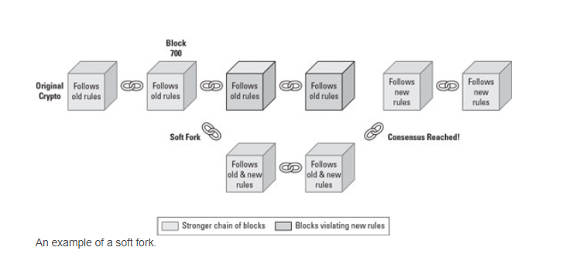
7. 1 Soft Forks
Example: “A soft fork is set to happen at block 700. The majority of the community may support the stronger chain of blocks following both the new and old rules. If the two sides reach a consensus after a while, the new rules are upgraded across the network. Any non-upgraded nodes who are still mining are essentially wasting their time. The community comes back together softly.” ⁵
[16]
TRANSITION – Project Reference: 2019-1-MT01-KA202-051255
This project is funded by the European Union ERASMUS+ Program – Key Action 2 Cooperation for innovation and the exchange of good practices.

Slide 40
7. 2 Hard Forks
Hard forks are huge changes due to the fact that they are a change to the protocol that is not backward compatible.
Hard forks are usually implemented under extreme conditions, so only if they are necessary;
TRANSITION – Project Reference: 2019-1-MT01-KA202-051255
This project is funded by the European Union ERASMUS+ Program – Key Action 2 Cooperation for innovation and the exchange of good practices.

Slide 41
7. 2 Hard Forks
Example: “Suppose the protocol's pre-existing rules prescribe 5 MB as the block size, as in the above example. However, the new protocol specifies that a data size of 7MB per block must be reached for it to be attached to the blockchain. In this case, the old nodes are not compatible with the new protocol. The miner must now decide whether to continue running his node on the old protocol or update it to the new one.”⁶
6 What are Soft Forks and Hard Forks? | Coinmonks (medium.com)
TRANSITION – Project Reference: 2019-1-MT01-KA202-051255
This project is funded by the European Union ERASMUS+ Program – Key Action 2 Cooperation for innovation and the exchange of good practices.

Slide 42
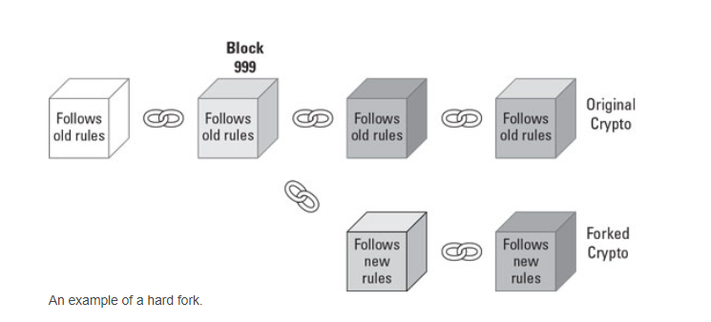
7. 2 Hard Forks
Example: “The community can say that the new protocol will go live when block 999 is published to the cryptocurrency blockchain.
When the currency reaches that block number, the community splits in two. Some decide to support the original set of rules, while others support the new fork. Each group then starts adding new blocks to the fork it supports. At this point, both blockchains are incompatible with each other, and a hard fork has occurred. In a hard fork, the nodes essentially go through a contentious divorce and don’t ever interact with each other again. They don’t even acknowledge the nodes or transactions on the old blockchain” ⁷
[17]
7 Cryptocurrency Forks or Investment Splits - dummies
TRANSITION – Project Reference: 2019-1-MT01-KA202-051255
This project is funded by the European Union ERASMUS+ Program – Key Action 2 Cooperation for innovation and the exchange of good practices.

Slide 43
7. 3 Ethereum’s Hard Forks
It is important to mention Ethereum’s Hard Forks since they are so detrimental and significant to Ethereum’s well-being.
There have already been several hard forks in the history of Ethereum and there are others planned for the near future.
The most discussed hard fork of Ethereum was performed on July 20, 2016 necessary after the DAO attack.
TRANSITION – Project Reference: 2019-1-MT01-KA202-051255
This project is funded by the European Union ERASMUS+ Program – Key Action 2 Cooperation for innovation and the exchange of good practices.

Slide 44
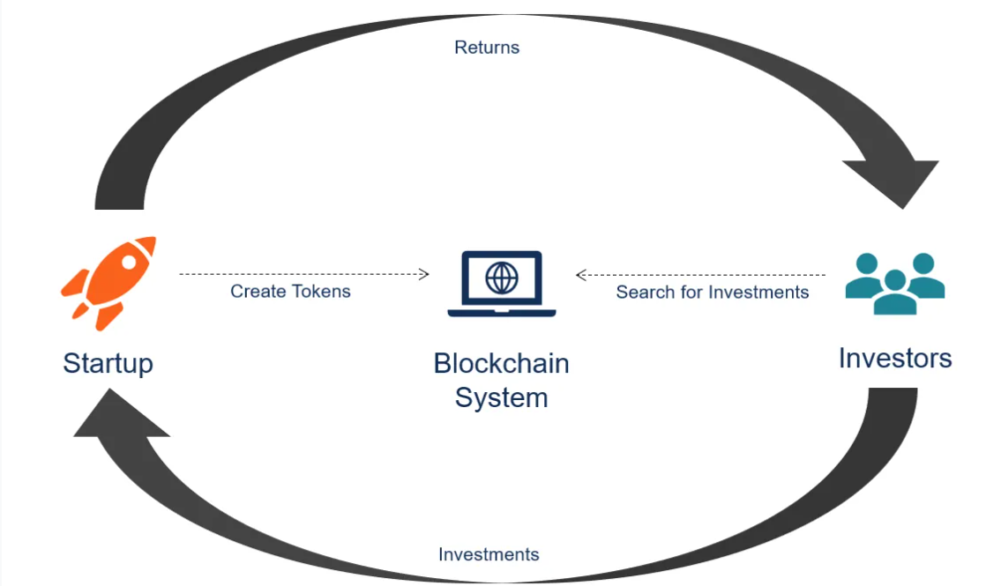
8. Initial Coin Offerings (ICOs)
An initial coin offering (ICO) is a type of capital-raising activity in the cryptocurrency and blockchain environment. The ICO can be viewed as an initial public offering (IPO) that uses cryptocurrencies even though there are some crucial differences between the two fundraising activities. Startups primarily use an ICO to raise capital.
[18]
TRANSITION – Project Reference: 2019-1-MT01-KA202-051255
This project is funded by the European Union ERASMUS+ Program – Key Action 2 Cooperation for innovation and the exchange of good practices.

Slide 45
8.1 Differences between IPO and ICO
IPO | ICO
IPO are a form of crowdfunding which targets the general public. The public offering is a democratized form of investing due to the fact that almost anyone can become an investor. However, due to regulatory concerns, private ICOs are becoming a more viable option with regards to public offerings. | In private ICO, only a limited number of investors can participate in the process. Generally, only accredited investors (financial institutions and high net-worth individuals) can participate in private ICOs, and a company can choose to set a minimum investment amount.
Initial Public Offering | Initial Coin Offering
Issues shares of a company | Issues cryptocurrency tokens
Regulated by Authorities | Unregulated
Centralized by a stock exchange | Decentralised
TRANSITION – Project Reference: 2019-1-MT01-KA202-051255
This project is funded by the European Union ERASMUS+ Program – Key Action 2 Cooperation for innovation and the exchange of good practices.

Slide 46
8.2 How does an ICO work?
^{[19]}
TRANSITION – Project Reference: 2019-1-MT01-KA202-051255
This project is funded by the European Union ERASMUS+ Program – Key Action 2 Cooperation for innovation and the exchange of good practices.

Slide 47
GLOSSARY
Account: an account is an entity with an Ether balance that can send transactions on Ethereum.
Blockchain: public database, updated and shared within many computers among the network. The blockchain is the technology behind Etheruem: the digital record of transaction sets up a chain of blocks. Note that block's data cannot be amended/changed without changing all subsequent blocks, such process would require the consensus of the entire network.
DAO (decentralised autonomous organisation): a sort of community, implying an effective/safe way to work with people around the globe and manage treasury for a specific scope.
Dapp: Decentralised application that uses blockchain platforms and the relevante P2P networks.
EVM bytecode: is a low-level programming language which is compiled from a high-level programming language such as solidity. It is not readable for humans but readable for the machine.
TRANSITION – Project Reference: 2019-1-MT01-KA202-051255
This project is funded by the European Union ERASMUS+ Program – Key Action 2 Cooperation for innovation and the exchange of good practices.

Slide 48
GLOSSARY
Ether: cryptocurrency of Ethereum.
Ethereum Account: a user’s public and private key pair.
Ethereum Address: it is based on the public key generate by the wallet, is what get sent to Dapps and is what money/tokens are sent to.
Ethereum Virtual Machine (EVM): global virtual computer. Every participant on the Ethereum network stores and agrees on its state. Moreover, participants can demand the execution of arbitrary code on the EVM, keeping in mind that code execution changes the state of the EVM.
Gas: essential element to the Ethereum network since it is the fuel that allows it to operate.
Key: number that identifies the user. there are two type of keys: public and private. The former proves the ownership of an account and helps to prove that a transaction is actually signed by the sender. The latter is used by others to verify the sender by checking the digital signature made with relevant private key.
TRANSITION – Project Reference: 2019-1-MT01-KA202-051255
This project is funded by the European Union ERASMUS+ Program – Key Action 2 Cooperation for innovation and the exchange of good practices.

Slide 49
GLOSSARY
Node: Every computer in the network is know as "node". Each node has the same data and, due to the consensus mechanism, new blocks and chain shall agreed upon by every node (computer) of the network. Nodes are therefore the real-life machines which store the EVM state. They communicate with each other to pass on information about the EVM state and new state changes. For the sake of completeness, it is called “Client” the application on the computer able to "run" a node (widely used Clients are Geth and OpenEthereum).
Peer-to-peer (P2P) platform: Platform that allows users to interact without going through an intermediary.
TRANSITION – Project Reference: 2019-1-MT01-KA202-051255
This project is funded by the European Union ERASMUS+ Program – Key Action 2 Cooperation for innovation and the exchange of good practices.

Slide 50
GLOSSARY
Proof-of-Work consensus: consensus mechanism (process through which reaching an agreement about information on the network) currently used by Ethereum.
State: it is what is representable by a computer at a given moment. The state is an enormous data structure which keeps all accounts linked by hashes and reducible to a single root hash stored on the blockchain.
Token: A type of digital asset that may be exchanged within a blockchain. A token is used as a representation of assets (material and digital) or rights (ownership to an asset or access to a service).
Fungible token (interchangeable tokens): like voting tokens, staking tokens or virtual currencies.
Non-fungible token: like a deed for artwork or a song.
TRANSITION – Project Reference: 2019-1-MT01-KA202-051255
This project is funded by the European Union ERASMUS+ Program – Key Action 2 Cooperation for innovation and the exchange of good practices.

Slide 51
GLOSSARY
Transaction: Cryptographically signed instructions from accounts that may either result in message calls or in contract creation.
Turing-complete virtual machine: a machine that, given enough time and memory along with the necessary instructions, can solve any computational problem.
Wallet: A product that lets you manage your Ethereum account: view your account balance, send transactions, and more. The most popular Ethereum wallet is Metamask.
TRANSITION – Project Reference: 2019-1-MT01-KA202-051255
This project is funded by the European Union ERASMUS+ Program – Key Action 2 Cooperation for innovation and the exchange of good practices.

Slide 52
BIBLIOGRAPHY 1
https://ethereum.org/en/history/#whitepaper
https://coinmarketcap.com/alexandria/glossary/ethereum-virtual-machine-evm
https://takenobu-hs.github.io/downloads/ethereum_evm_illustrated.pdf
https://ethereum.org/en/developers/docs/intro-to-ethereum/
https://www.bitdegree.org/learn/ethereum-virtual-machine
https://ethereum.org/en/developers/docs/nodes-and-clients/
https://ethereum.org/en/wallets/
https://ethereum.org/en/nft/
https://medium.com/@markmuskardin/mastering-the-fundamentals-of-ethereum-for-new-blockchain-devs-part-iii-wallets-keys-and-4cd3175b535b
https://ethereum.org/en/developers/docs/evm/
https://cointelegraph.com/ethereum-for-beginners/ethereum-wallets
https://medium.com/@roberto.g.infante/smart-contracts-the-brain-of-dapps-cf886bb1bbb6
https://www.gemini.com/cryptopedia/blockchain-types-pow-pos-private#section-blockchain-types
https://ethereum.org/en/developers/docs/consensus-mechanisms/pow/
TRANSITION – Project Reference: 2019-1-MT01-KA202-051255
This project is funded by the European Union ERASMUS+ Program – Key Action 2 Cooperation for innovation and the exchange of good practices.

Slide 53
BIBLIOGRAPHY 2
https://www.bitdegree.org/learn/ethereum-virtual-machine
https://ethereum.org/en/developers/docs/smartcontracts/#:~:text=A%20%22smart%20contract%22%20is%20simply,runs%20on%20the%20Ethereum%20blockchain.&text=Smart%20contracts%20are%20a%20type,network%20and%20run%20as%20programmed
https://medium.com/@markmuskardin/mastering-the-fundamentals-of-ethereum-for-new-blockchain-devs-part-iii-wallets-keys-and-4cd3175b535b
https://www.eublockchainforum.eu/sites/default/files/reports/report_legal_v1.0.pdf
https://europeanlawinstitute.eu/projects-publications/current-projects-upcoming-projects-and-other-activities/current-projects/blockchains/
"Nevada Passes Pro-blockchain Law - Fin Tech - United States".
"Arizona Passes Groundbreaking Blockchain and Smart Contract Law – State Blockchain Laws on the Rise"
TRANSITION – Project Reference: 2019-1-MT01-KA202-051255
This project is funded by the European Union ERASMUS+ Program – Key Action 2 Cooperation for innovation and the exchange of good practices.

Slide 54
BIBLIOGRAPHY 3
https://ethereum.org/en/developers/docs/dapps/
https://ethereum.org/en/dapps/
https://www.bitpanda.com/academy/en/lessons/what-is-a-dapp/
TRANSITION – Project Reference: 2019-1-MT01-KA202-051255
This project is funded by the European Union ERASMUS+ Program – Key Action 2 Cooperation for innovation and the exchange of good practices.

Slide 55
BIBLIOGRAPHY 4
https://ethereum.org/en/developers/docs/dapps/
https://www.bitdegree.org/learn/ethereum-virtual-machine
https://ethereum.org/en/developers/docs/gas/
https://medium.com/@roberto.g.infante/smart-contracts-the-brain-of-dapps-cf886bb1bbb6
TRANSITION – Project Reference: 2019-1-MT01-KA202-051255
This project is funded by the European Union ERASMUS+ Program – Key Action 2 Cooperation for innovation and the exchange of good practices.

Slide 56
BIBLIOGRAPHY 5
https://ethereum.org/en/developers/docs/dapps/
https://ethereum.org/en/dao/
https://www.yield.app/post/what-is-a-dao
TRANSITION – Project Reference: 2019-1-MT01-KA202-051255
This project is funded by the European Union ERASMUS+ Program – Key Action 2 Cooperation for innovation and the exchange of good practices.

Slide 57
BIBLIOGRAPHY 6
https://www.nytimes.com/2016/06/18/business/dealbook/hacker-may-have-removed-more-than-50-million-from-experimental-cybercurrency-project.html
https://www2.deloitte.com/ie/en/pages/technology/articles/DAO-Attack-Analysis.html
https://www.planetcompliance.com/nutshell-dao-steal-60-million-worth-cryptocurrency/
https://ogucluturk.medium.com/the-dao-hack-explained-unfortunate-take-off-of-smart-contracts-2bd8c8db3562
https://www.nytimes.com/2016/06/18/business/dealbook/hacker-may-have-removed-more-than-50-million-from-experimental-cybercurrency-project.html
https://www.coindesk.com/understanding-dao-hack-journalists
https://www.gemini.com/cryptopedia/the-dao-hack-makerdao#section-the-dao-hack
TRANSITION – Project Reference: 2019-1-MT01-KA202-051255
This project is funded by the European Union ERASMUS+ Program – Key Action 2 Cooperation for innovation and the exchange of good practices.

Slide 58
BIBLIOGRAPHY 7
Ethereum Fork Guide: All You Need To Know About Ethereum Hard Fork (bitdegree.org)
Cryptocurrency Forks or Investment Splits – dummies
What are Soft Forks and Hard Forks? | Coinmonks (medium.com)
History and Forks of Ethereum | ethereum.org
TRANSITION – Project Reference: 2019-1-MT01-KA202-051255
This project is funded by the European Union ERASMUS+ Program – Key Action 2 Cooperation for innovation and the exchange of good practices.

Slide 59
BIBLIOGRAPHY 8
Initial Coin Offering (ICO) - Overview, Types, and How it Works (corporatefinanceinstitute.com)
What are ICOs and IEOs in blockchain space? — Bitpanda Academy
TRANSITION – Project Reference: 2019-1-MT01-KA202-051255
This project is funded by the European Union ERASMUS+ Program – Key Action 2 Cooperation for innovation and the exchange of good practices.

