Slide 1
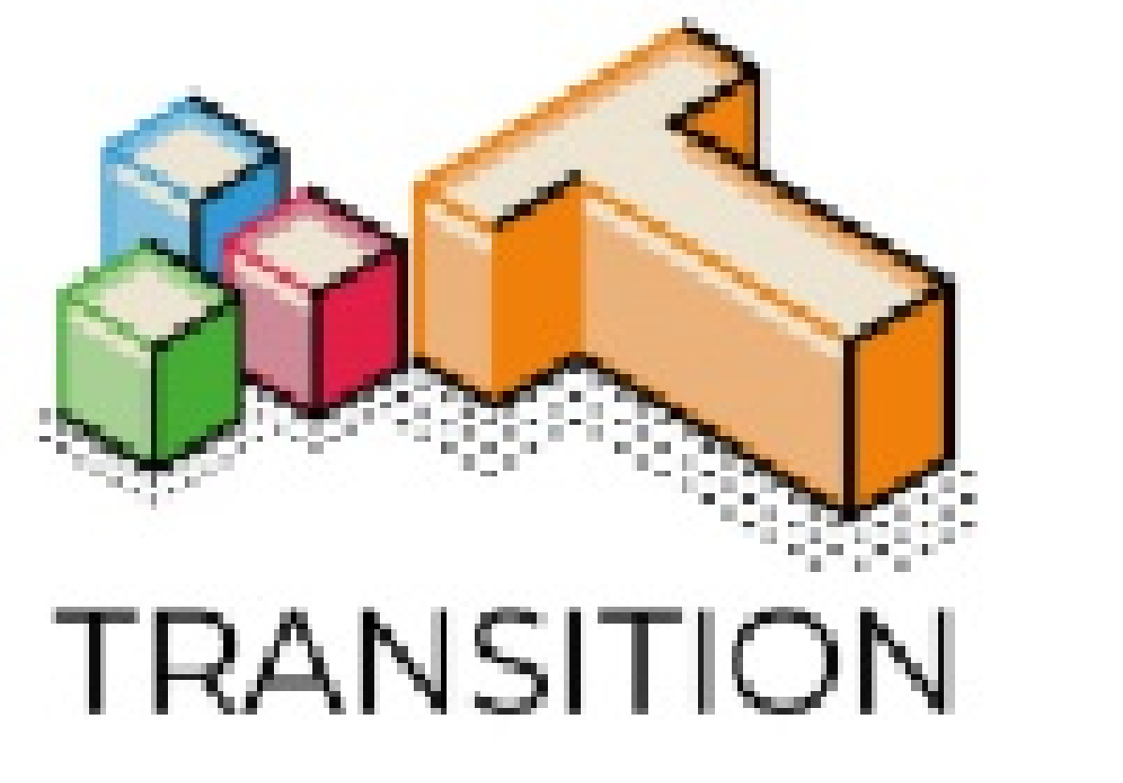
Subject E. Blockchain and innovations. Cross-industry potential. Our decentralized future.
(Lidi Smart Solutions)

Slide 2
Blockchain and Latest Developments - evolution of blockchain.
Blockchain has now been around for just over a decade and is one of the most innovative and fastest growing technologies.
It is crucial to keep up with the latest developments as they provide meaningful solutions to problems that could not be dealt with in this way before.

Slide 3
Public, Private, and Hybrid Blockchains
A public blockchain which is as suggested, open to anyone. Everyone is equal and there are no restrictions on the participation of individuals.
Anyone can read the blockchains, make transactions, mint transactions, verify the network, run a node, or anything else as long as the protocol is followed. The most known examples of public blockchain are Bitcoin and Ethereum.

Slide 4
Public, Private, and Hybrid Blockchains
In a private blockchain parties have limited access. This is most commonly used within private corporations. A company can choose to use a blockchain as a software solution for storing data immutably.
Within the company, a manager would control permissions and give different employees an access. For example, they can give access to the managers to write data and only allow workers to read data. Furthermore, this data can either be shown or hidden from the public and customers.

Slide 5
Public, Private, and Hybrid Blockchains
A hybrid blockchain strives to take the best of both worlds and combine public and private features for the particular use case of the blockchain. Hybrid blockchain architecture is flexible and customizable.
The goal is for the blockchain to have both controlled access and freedom at the same time. A hybrid blockchain has the features of a public blockchain while allowing access to trusted parties only.
Whoever is in charge of the blockchain may grant access to individuals, but the system is anonymous, transparent, and secure after this gateway.
An example of a hybrid blockchain worth looking into is DragonChain.

Slide 6
Hyperledger, Azure, Amazon-Managed Blockchain
As a fast-growing industry, it is important to lower the barrier for entry so that new people of all skill and creativity levels can be quickly brought up to speed.
In association with this are organizations such as IBM, that provide building blocks in the form of code solutions. They are an open-source project hosted by the Linux foundation.
Azure Blockchain Service by Microsoft and Amazon-Managed Blockchain also provide software solutions and similar services. In mid September, 2021 Azure Blockchain Service migrated to Quorum Blockchain Service.
They also provides educational materials in the blockchain industry.

Slide 7
2. Blockchain and Web 3.0. IPFS.
You may have heard of the concept of web 3.0, but what does this refer to?
Each version of the web is a disruption, starting back in the 1990s when the internet first came into existence and started becoming more publicly accessible.
Web 1.0 offered static websites, no interaction. Most websites were a file.
Web 2.0 offers the use of databases to host websites. The websites can be updated in real-time. It also allows for users to post comments.
This change progressed in the 2000s as more features and tech got developed, including server-side scripting, in-browser text editing, and more, which also provided the basis for forums and social media.

Slide 8
2. Blockchain and Web 3.0. IPFS.
Blockchain is a distinctive change between web 2.0 and web 3.0.
The core idea for web 3.0 is that the internet will be taken back by the people.
It will become peer-to-peer rather than run on company servers.
Data will not be stored on servers but on immutable, secure, decentralized blockchains.
The internet will be permissionless as these blockchains will be public and companies will not have the power to restrict anyone’s rights to read or write.
Another key feature constituting a major part of web 3.0 is the integration of AI and IoT. Web 3.0 is the web of intelligence, where the interactions will not only be between people and software, but also between software and software.

Slide 9
2. Blockchain and Web 3.0. IPFS.
The next major change between the web 2.0 and web 3.0 is the underlying file system. The files will be stored and accessed differently since servers will not function as they do now.
Currently, the web is based on DNS and the HTTP protocol. Every device has an IP address. HTTP is a server-client protocol which means that your device asks a server for information via its IP and it sends that data to your IP.
The change will be in the fact that there will no longer be designated servers. Instead, each device will serve both as a client and a server which is the basis for peer-to-peer networks. The most likely protocol/ software solution that will replace HTTP is called IPFS.
In place of providing content based on where it is located, IPFS uses content addressing to know what is in the content based on its address.

Slide 10
2. Blockchain and Web 3.0. IPFS.
Advantages of IPFS over HTTP
IPFS is more secure. SSL is a protocol for establishing authenticated and encrypted connections between networked computers which is no longer necessary with IPFS.
IPFS also keeps all versions of a file as well as the file. The data will be distributed in many places so it is less likely to get lost whereas a server that is not backed up can suffer physical damage and make the data irretrievable.
The data can be moved without changing the address which will make it much easier to locate and keep track of. IPFS is also much faster than HTTP. It is transport-layer agnostic, which means it can work over any transport layer (from TCP to Bluetooth).

Slide 11
3. The challenge of interoperability.
Interoperability is the ability to see and access information across various blockchain networks and the ability of those decentralized networks to communicate with one another without any intermediaries.
Interoperability is one of the most prevailing challenges in the blockchain world.
Currently, there are over 800 blockchains and they are all their own separate networks.
It is incredibly difficult and inefficient to migrate data or value between chains.
A possible solution right now is to use a centralized exchange and give them tokens on one network, sell them, buy other tokens, and then withdraw them on a different network. It is obviously highly inefficient path.
WBTC is an exchange specifically designed to put BTC on ETH.

Slide 12
3. The challenge of interoperability.
For people to have the decentralized freedom we want, all of these public blockchains need to be connected so everyone can take advantage of all of the services and solutions they provide.
A very obvious example is wanting to migrate BTC onto ETH.. This will not be a trustworthy process if a centralized exchange needs to be involved every time.
It makes sense to want interoperability due to the different strengths and weaknesses of different chains:
For full access to DeFi, you may want to keep assets on Ethereum.
For cheap transactions, you may want to use another network.
For fast execution you may want a different network,.
Liquidity is also an important factor, the list goes on.
So far it has also been one of the biggest challenges to tackle.

Slide 13
3. The challenge of interoperability.
Solutions are being worked on with full force.
Chainlink is developing CCIP (Cross-Chain Interoperability Protocol).
Polkadot, Cardano, and Cosmos are also focused on interoperability, and there are bridges that attempt to connect chains. An example is Clover which is between Polkadot and Ethereum.
Solana is devoted to that challenge as well, developing Wormhole - a cross-chain bridge between Solana and Ethereum.

Slide 14
4. The challenge of scalability.
As a network becomes more popular and used by an ever growing user base, scalability challenges become more noticeable and critical. These challenges affect the number of transactions that can be processed per second, their cost, the network latency (and hence security). It is natural that as the number of users increases, so will the number of transactions.
Photo by Jeremy Bezanger on Unsplash

Slide 15
4. The challenge of scalability.
Every technology is rated for a certain number of transactions per second which is based on the consensus method, storage method (how many transactions can be fit in 1 block and its memory demand), and the speed of the ability for nodes to be updated with the new information.
If the number of transactions surpasses the rating of the network, it becomes unusable since some transactions cannot be minted on time.

Slide 16
4. The challenge of scalability.
The speed at which each new block is spread across the network is also critical since 51% or more nodes must have the correct and up-to-date transaction information for the network to operate properly.
This time should be as low as possible which is up to the software (how compact the blocks can be in terms of size) and hardware (how quickly information can be sent through the internet to reach the other nodes).
Finally, in some networks the transactions that pay a higher fee have priority. In this case, if a network is congested, the transaction costs will increase beyond usability hence people will migrate to a more efficient network/technology.

Slide 17
4. The challenge of scalability.
There are already solutions being developed to combat this. There are 2 ways to implement scaling solutions, namely on-chain, and off-chain.
On-chain means that the Ethereum layer 1 protocol will have to be altered for these solutions to come into play.
The on-chain solution that is being looked at the most to lower transaction fees. The idea is to split the Ethereum database horizontally, creating new chains (or shards). This will lighten the load so that different validators can process different transactions rather than trying to squeeze all of the transactions into one place at the same time.

Slide 18
4. The challenge of scalability.
As for off-chain solutions, there are many creative ways to do this, some of which rely on layer 1 for security while others don’t. One type of scaling solution is called a rollup. They are on layer 2 but sit parallel to the main Ethereum chain.
What they do is “roll-up” transactions, in other words, thousands of transactions can be put into one rollup block. This is then sent to mainnet as CALLDATA, which is much cheaper than layer 1 storage and computation. These rollups will also benefit if sharding is implemented.

Slide 19
4. The challenge of scalability.
The next off-chain scaling solution is called a state channel. Let’s say you want to play a game against an opponent. You open a state channel. Every move either player makes is recorded off-chain as a transaction. This also allows for the chronology of the moves to be maintained. Once the game finishes, the channel closes and the “final state” is signed by both players. It is then sent as one transaction, hence reducing congestion on the network and the participants only need to pay 1 fee.
The next way to reduce traffic on mainnet is called a plasmachain. This is like a separate chain but it is anchored to mainnet. It is essentially a copy of mainnet. An example of this is Polygon (previously Matic). These are also sometimes referred to as child chains. There is no limit to how many can be created.

Slide 20
4. The challenge of scalability.
The final scaling solution is different in that it does not use Ethereum for immutability. This solution is called a sidechain. By creating a new chain, all of its characteristics can be altered for it to serve a specific purpose.
This chain is a copy of Ethereum, even if block times and other parameters are different, which means it is fully EVM compatible. It is connected with a two-way bridge to mainnet. Since it is a copy of Ethereum, the benefit is you can deploy identical code.

Slide 21
5. Potential and limitations a decade from the beginning.
Blockchain is not a solution to every problem that presents itself.
While there are new ideas in the industry every day, for now it still remains that blockchain has very specific use cases where it is of any benefit over traditional systems.
Currently a lot of the benefits still owe it to the infrastructure and philosophy of the technology - being public, trustless, immutable.
It is critical to understand when blockchain is a relevant solution and when it may be less effective.

Slide 22
5. Potential and limitations a decade from the beginning.
Factors to consider:
Who will be accessing the data. If only one entity will need to read the data, a spreadsheet is a much more simple solution which is more cost effective, easier to use, takes less time, energy, and storage. If the data is shared, however, it may be good to consider blockchain.
The same goes for writing data. If only one person needs to write data, even if more people need to read it, you do not need a blockchain, but can stick to solutions such as databases.

Slide 23
5. Potential and limitations a decade from the beginning.
Factors to consider & when to use a blockchain solution:
The context of the data. Blockchains are particularly useful when there is a conflict of interest. This is when participants are fighting over who has control of the data. As we know, on a blockchain no one has control, which is why it is a good solution in this scenario.
Another issue that can be faced is a lack of trust. If you need to ensure trust in the data to someone who has any reason not to trust you, a blockchain is a relevant solution.

Slide 24
5. Potential and limitations a decade from the beginning.
Advantages & a potential use:
Blockchain is also useful when it is important to make data tamper proof and immutable.
Another advantage blockchain has over any other technology is that it can be used to remove intermediaries.
Finally, blockchain is useful for proving authority or ownership or identity. By linking ownership to your private key through, for example an NFT, it is easy to show that you are indeed who you say you are.

Slide 25
5. Potential and limitations a decade from the beginning.
Limitations:
If flexibility or frequently update are needed, blockchain os not a relevant solution.
In case of large files or a lot of data need to be stored, blockchain is definitely not suitable since the nodes in the network need to update and this can be incredibly slow.
Blockchain also has certain hardware requirements - you need multiple nodes for the system to be of any benefit, and it may take some computational power to run.

Slide 26
6. Interaction with other innovative industries/technologies
There are currently 3 main technological industries that are growing at an astonishing speed. These are Blockchain, Artificial Intelligence, and the Internet of Things.
When these 3 technologies are combined, the potential grows rapidly. This is what the future will most likely look like.

Slide 27
Blockchain and the IoT
In the current state of the Internet, there is a problem with identity fraud.
An outside party provides your online identification.
SSI (Self-sovereign identity) allows people to be in control of their own identity through blockchain. This is because instead of using an account belonging to a company to show credentials, your private key is all you will need, and no one has that except you!
However, is that this may be more relevant to commercial uses such as identifying objects.

Slide 28
Blockchain and the IoT
IoT is a network of internet-connected physical devices.
They have sensors which can be used for collecting data.
The sensors allow them to communicate with their environment while software provides the tools necessary for processing this information. All of the devices connect together allowing for a deeper understand of occurrences.
In 2018 this network had more than 22 billion devices connected.
It is continuing to grow rapidly.

Slide 29
Blockchain and the IoT
Some of the consumer applications of IoT include:
Smart home automation - devices such as lights, security systems, air conditioning, TVs, etc.
Wearable electronics - which can collect and analyze information about your body and transmit it if needed.
Remote health monitoring for those in need - emergency notifications and real-time health analytics.
Others.
Enterprise applications are the automation of: transportation, manufacturing of products, agriculture, energy grid, etc.
Essentially, IoT is the information layer.

Slide 30
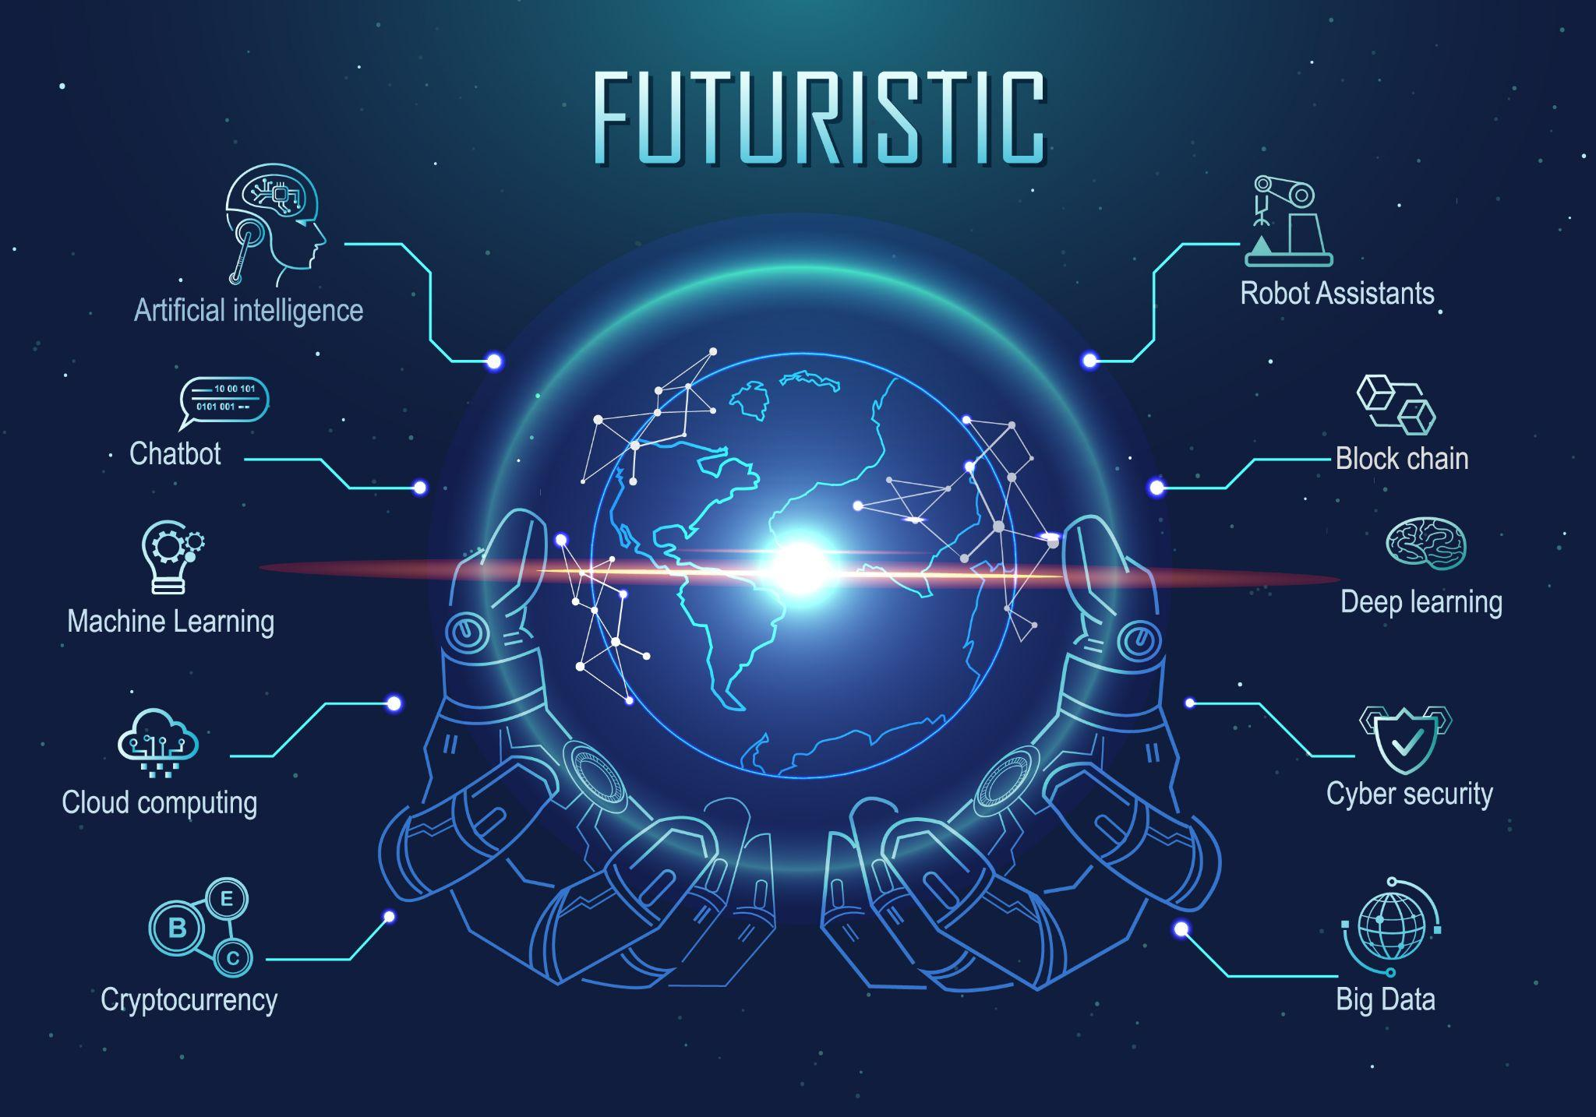
Blockchain and the AI
As a separate technology, we have AI.
AI can be used to analyse, interpret, and find meaning in the mass of data collected by the device sensors.
It will be able to identify patterns that no human or computer currently can.
AI is about training computers how to perform tasks that would usually need human input as as well as providing them with algorithms to self train using the newly collected data.

Slide 31
Blockchain, the IoT and AI
There are Dapps (distributed applications) that combine Blockchain with the IoT as well as Blockchain with AI. The potential of such cross technology solutions is endless.
A step further are the applications that get the 3 technologies together.
Once combined, AI will be able to make decisions upon which the devices in the IoT will act. Blockchain is the glue that allows for AI and IoT to work together, securely storing all of the transactions and settling payments. It also allows for smart contracts to exist which enable automatic execution and enforcement of contracts under given conditions. Digital ownership and custom financial instruments will also be relevant.

Slide 32
Blockchain, the IoT and AI
Taking all of this together, we have the IoT collecting massive quantities of data in a cost-effective way, AI analyzing this data to find meaningful patterns otherwise not identifiable by humans or computers, and finally blockchain immutably and securely recording all of the transactions and storing them with no single point of failure (centralized server or company record), allowing autonomous systems to interact with each other.

Slide 33
Blockchain in other industries
While blockchain can be combined with other technology to unlock endless possibilities, it will also disrupt other industries by itself.
Blockchain technology is not limited to the public blockchain industry - it will change how many industries operate and provide opportunities that were previously not possible.
Decentralization motivates collaboration. Without a big company making decisions, people are pushed to be creative and find their own solutions.
Since it is difficult to do anything meaningful alone, this naturally allows for small groups with aligned goals to form.

Slide 34
Blockchain in other industries
Blockchain lowers the barrier to entry in many well-established industries by disrupting the infrastructure. Previously only licensed companies had the ability to offer leveraged assets.
One of the industries blockchain will revolutionize is real estate - blockchain will do to real estate investing what the internet did to stock investing.
Through tokenization, a property can be owned by multiple entities. As said previously, this lowers the barrier to entry. This would allow anyone to invest any amount (even really small quantities) into any available property and reap proportional rewards.

Slide 35
Blockchain in other industries
Blockchain lowers the barrier to entry in many well-established industries by disrupting the infrastructure. Previously only licensed companies had the ability to offer leveraged assets.
Among the industries that will be disrupted by implementation of Blockchain Technology are Finance, Transportation and Logistics, Healthcare, Public and Retail Sector, Agriculture and Mining, Construction, Telecom, Energy Sectors, Education, Entertainment, ICT, the Governance, etc.

Slide 36
7. Our decentralized future.
In the near future we could expect an explosion the NFT market and the Blockchain-based gaming.
NFTs.
With the recent hype you have likely heard about NFTs. NFT stands for non-fungible token. Fungible since it is uncommon, means “replaceable by an identical item”. As suggested by the name, an NFT is unique, whereas other tokens are interchangeable.
This gives NFTs many use cases. One of the most promising solutions that NFTs provide is digital ownership. Thanks to the security and immutability of blockchain technology, it is a much better way of organizing ownership, especially when it comes to the culture and art.

Slide 37
7. Our decentralized future.
The Internet is upgrading from the internet of information to the internet of value.
With it individuals will have equal opportunity to use services since their identity will not be a factor. Everyone will have more freedom as the technology will provide solutions to complex problems.
The infrastructure of the internet will be more convenient for the user as they will not rely on servers that powerful people running large companies can control.

Slide 38
7. Our decentralized future.
Crowdfunding will be easier, the world will be peer to peer, hence more efficient without intermediaries.
There will be no controlling authorities such as companies that have a monopoly on services and own your data. You will have control over your own online property and identity.
Transactions will be transparent and anonymous. Content will be accessible through a more efficient system, and businesses will provide more value in the increasingly competitive markets rather than markup price because they can.

Slide 39
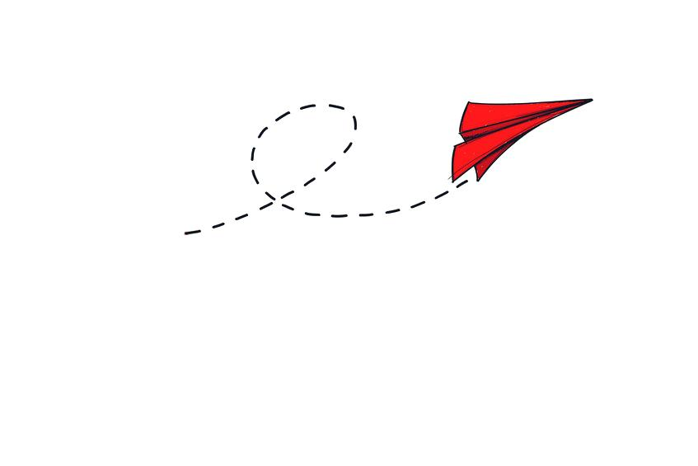
7. Our decentralized future.
Many industries will be revolutionized.
Agricultural providers will receive what they deserve rather than accept the unfair prices. The origin of products and resources will be traceable resulting in improved ethics and trust.
As technology continues to evolve there will be endless possibilities that can not be predicted.
That is why it is important to try and understand how everything works and stay up to date with new ideas.

